Slide 1
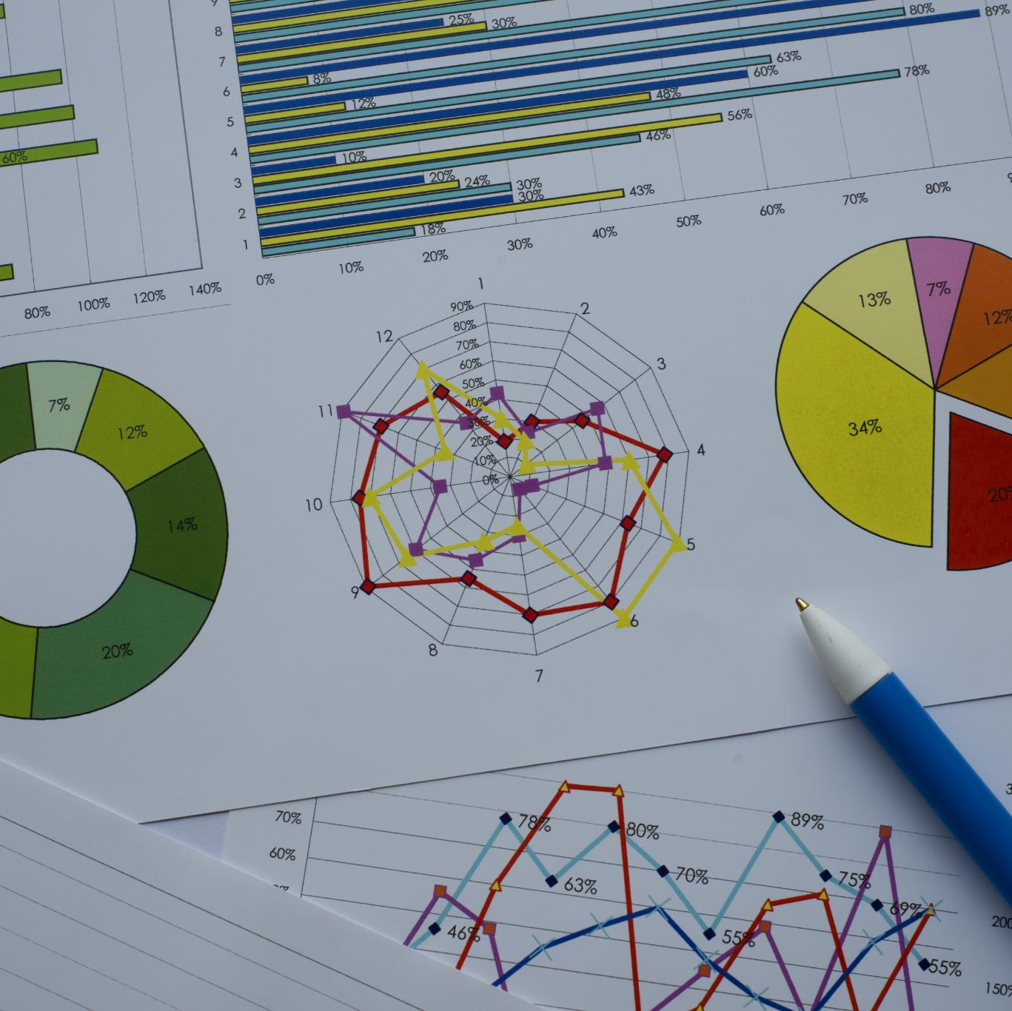
Our Journey in Data Visualization: From Data Collection to Insightful Dashboards
With EXCELERATE
Exploring the process from data to dashboards
TEAM-21
Notes:
AI-generated content may be incorrect. --- In this presentation, we will take you through our comprehensive journey in data visualization. We will explore our team dynamics, project objectives, data cleaning processes, exploratory data analysis, and the creation of insightful dashboards.

Slide 2
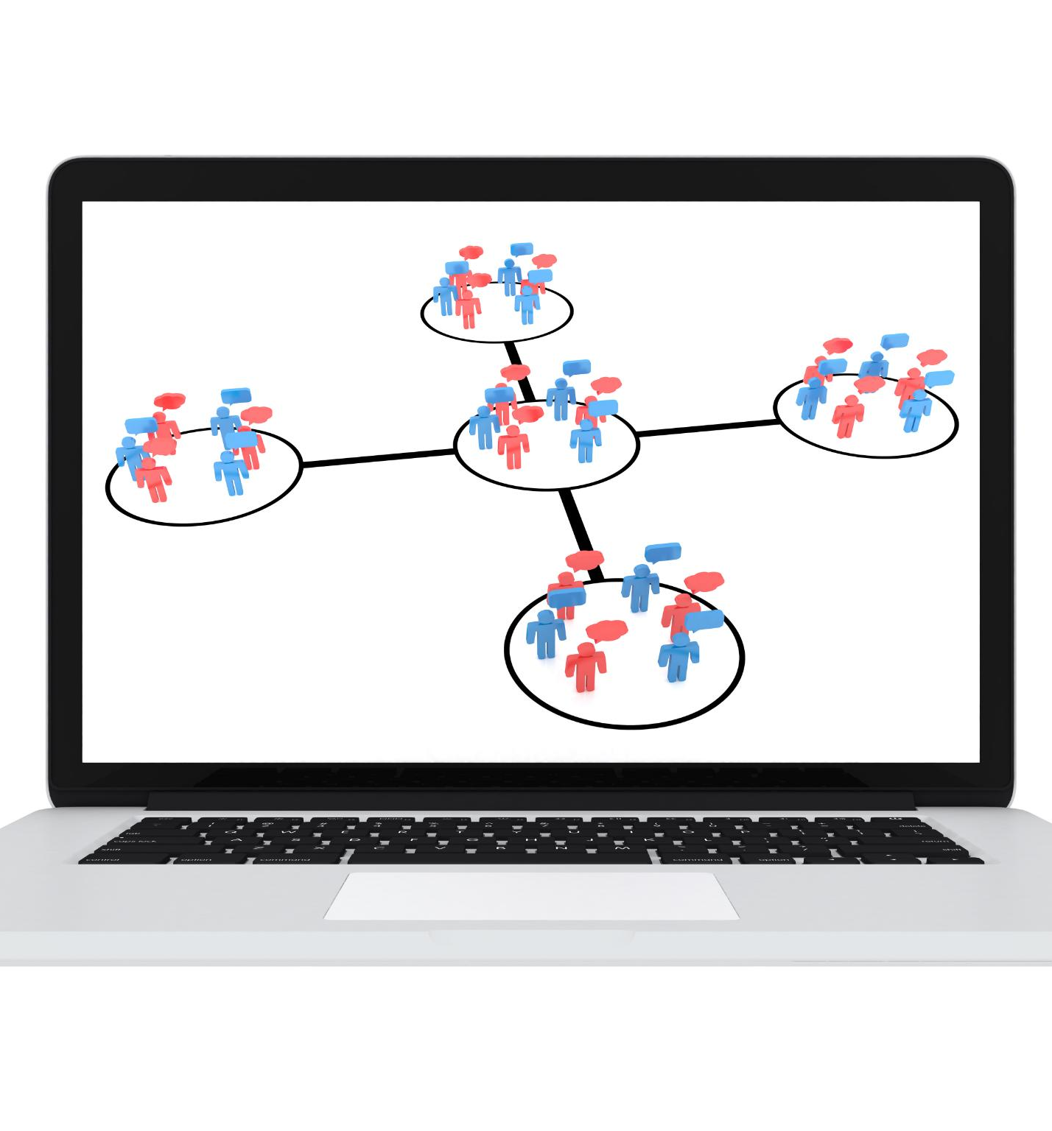
Agenda Overview
Meet Our Team
Objective of the Project
Data Understanding and Cleaning
Data Cleaning and Processing
Exploratory Data Analysis (EDA)
ETL Planning and Dashboard Creation with Wireframe
Looker Studio Dashboard
Notes:
This presentation will cover seven key areas: Firstly, an introduction to our team and their roles. Secondly, we will discuss the project's objectives and the significance of data visualization. Thirdly, we will dive into data understanding and cleaning processes, followed by exploratory data analysis techniques. Next, we will outline the ETL planning and dashboard creation. Finally, we will present the Looker Studio dashboard.

Slide 3
Meet Our Team
Notes:
Our team is a diverse group of professionals dedicated to data visualization. Each member brings unique expertise, and together we work collaboratively to achieve our project goals.

Slide 4

Introduction to Team Members
Aman Kumar (Project Manager)
Prakash Prajapat (Team Lead)
Vaneeza Sikander (Project Scribe)
Kimutai Wilbert (Project Lead)
Notes:
In this slide, we will introduce the core members of our team, detailing their backgrounds and how their individual skills contribute to the project's success.

Slide 5

Collaborative Efforts and Achievements
Importance of Collaboration
Collaboration fosters teamwork and enhances productivity, driving us towards our project goals efficiently.
Significant Achievements
Our collaborative efforts have led to significant achievements that have advanced our project and exceeded expectations.
Future Collaboration
Looking ahead, we aim to strengthen our collaborative efforts to continue achieving great results and innovations.
Notes:
Collaboration is key to our team's success. In this section, we will discuss our collaborative efforts and significant achievements that have propelled our project forward.

Slide 6
Objective of the Project
Notes:
The project's objectives guide our work and help us measure success. This section outlines the vision and goals that underpin our data visualization initiatives.

Slide 7

Project Goals and Vision
Data-Driven Decision Making
The project focuses on transforming raw data into insightful visuals that empower stakeholders to make informed decisions.
Project Vision
Our vision is to enhance decision-making through accessible and engaging visual representations of complex data sets.
Specific Project Goals
We aim to establish clear goals that guide the development of our data visualization tools and methodologies.
Notes:
Our project aims to create insightful visual representations of data that drive decision-making. This slide discusses the overall vision and specific goals of the project.

Slide 8

Importance of Data Visualization
Transforming Complex Data
Data visualization helps in converting intricate data sets into clear and concise visual formats that enhance understanding.
Effective Communication
Well-designed visualizations improve communication by making data more accessible to a wider audience, fostering better decision-making.
Enhanced Analysis
Data visualization aids in recognizing trends and patterns, allowing for more efficient and insightful analysis of information.
Notes:
Data visualization plays a crucial role in transforming complex data into understandable insights. Here, we will discuss why effective visualization is essential for communication and analysis.

Slide 9
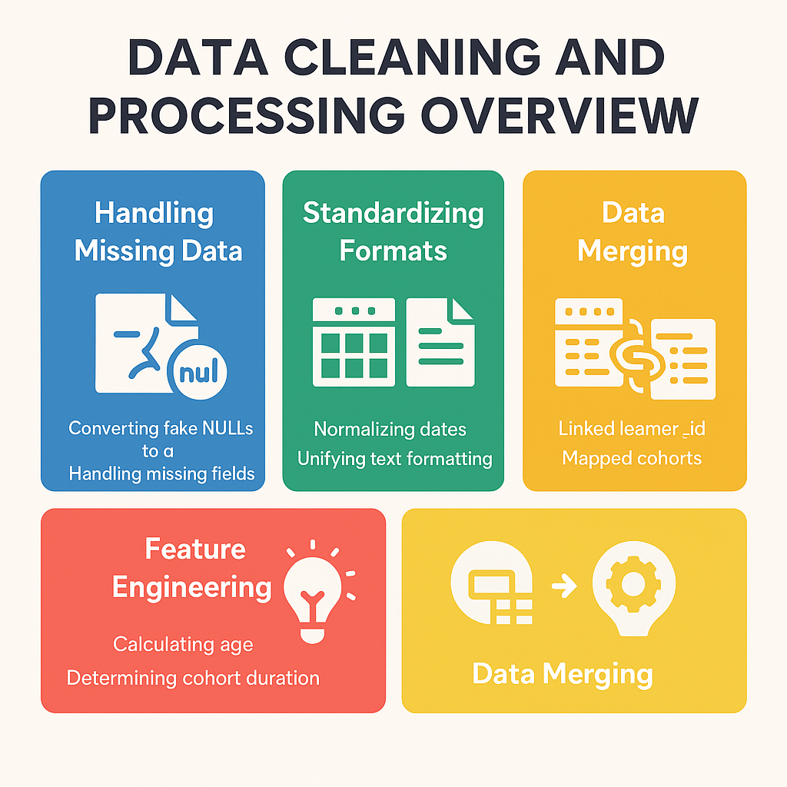
Expected Outcomes and Impact
Enhanced Data Understanding
Our project aims to improve clarity and insights from data, enabling stakeholders to make informed decisions.
Improved Decision-Making
We expect our work to elevate decision-making capabilities through better data interpretation and analysis.
Overall Project Impact
The anticipated outcomes will lead to greater efficiency and effectiveness in processes and strategies.
Notes:
We anticipate significant outcomes from our project, including enhanced data understanding and improved decision-making capabilities. This slide highlights the expected impact of our work.

Slide 10
Data Understanding and Cleaning
Notes:
Data understanding and cleaning is a critical step in our data visualization journey. It involves collecting, structuring, and preparing data for analysis.

Slide 11

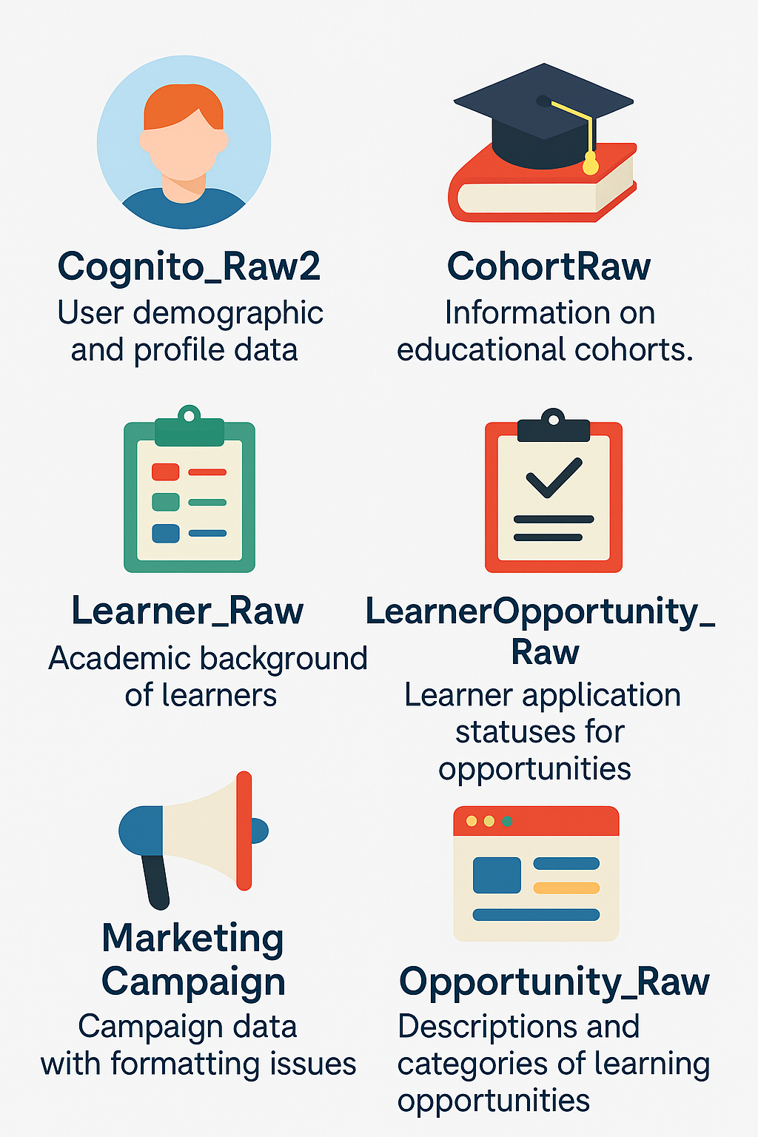
Data Structure and Formats
Importance of Data Structures
Data structures determine how data is organized, accessed, and manipulated, significantly affecting analysis efficiency.
Types of Data Formats
Various data formats like JSON, XML, and CSV serve different purposes in data storage and transmission.
Implications for Visualization
Choosing the right data structure and format is crucial for effective data visualization and accurate insights.
Notes:
Understanding data structure and formats is essential for effective analysis. This slide discusses the different types of data formats and their implications for visualization.

Slide 12

Initial Data Cleaning Processes
Error Identification
The first step in data cleaning is identifying errors in the dataset, such as missing values or duplicates.
Data Consistency
Ensuring data consistency involves standardizing formats and values to maintain uniformity across the dataset.
Data Transformation
Data transformation techniques are applied to convert data into a suitable format for analysis, enhancing its reliability.
Notes:
Initial data cleaning processes help eliminate errors and inconsistencies in our dataset. This section outlines the techniques used to prepare data for further analysis.

Slide 13
Data Cleaning and Processing
Notes:
Data cleaning and processing ensure that our data is accurate and ready for analysis. This section details the specific steps we take to refine our datasets.

Slide 14

Identifying and Summarizing Missing Data
Importance of Identifying Missing Data
Understanding and identifying missing data is essential to ensure the accuracy and integrity of our datasets.
Methods for Summarizing Missing Data
There are various methods to summarize missing data, including statistical techniques and data visualization tools to assess the extent of missing information.
Assessing Data Completeness
Assessing the completeness of datasets helps to determine the impact of missing information on data analysis outcomes.
Notes:
Identifying missing data is crucial for maintaining data integrity. This slide discusses methods to summarize and assess the extent of missing information in our datasets.

Slide 15
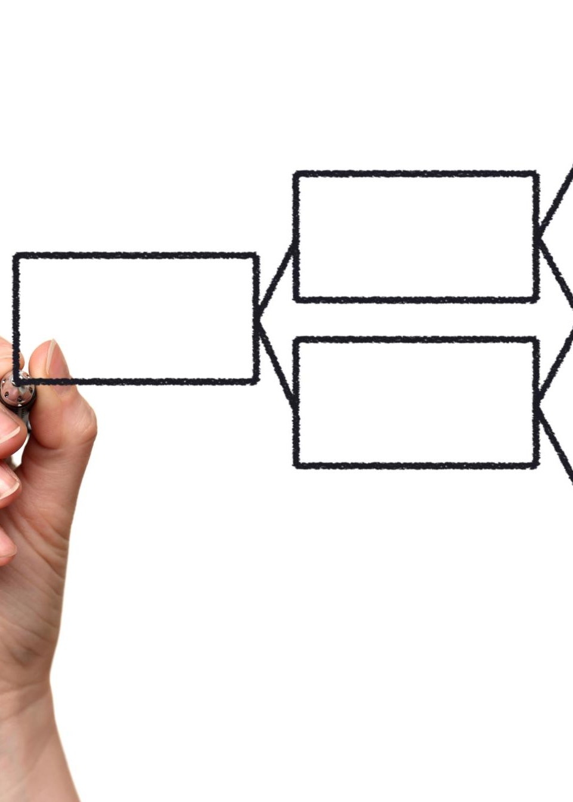
Techniques for Handling Missing Data
Imputation Techniques
Imputation techniques involve estimating missing values based on available data, enhancing data completeness and analysis accuracy.
Deletion Methods
Deletion methods remove records with missing values, ensuring that the analysis is conducted with complete data but may reduce sample size.
Considerations for Missing Data
Careful consideration of the missing data mechanisms is crucial, as it influences the choice of technique applied to handle the gaps.
Notes:
Handling missing data requires careful consideration. This section outlines various techniques, such as imputation and deletion, we employ to address missing values.

Slide 16

Data Familiarization and Transformation
Understanding Data
Familiarizing ourselves with the data is the first crucial step to ensure accurate analysis and insights.
Data Transformation Techniques
Transforming data into suitable formats facilitates easier analysis and enhances the accuracy of results.
Preparing for Analysis
Properly transformed data is essential for effective analysis and leads to better decision-making.
Notes:
Familiarizing ourselves with the data and transforming it into suitable formats for analysis is essential. This slide discusses our approach to data transformation.

Slide 17
Exploratory Data Analysis (EDA)
Notes:
Exploratory Data Analysis is a vital step in uncovering patterns and insights within the data. This section focuses on techniques and strategies we utilize during our EDA.

Slide 18
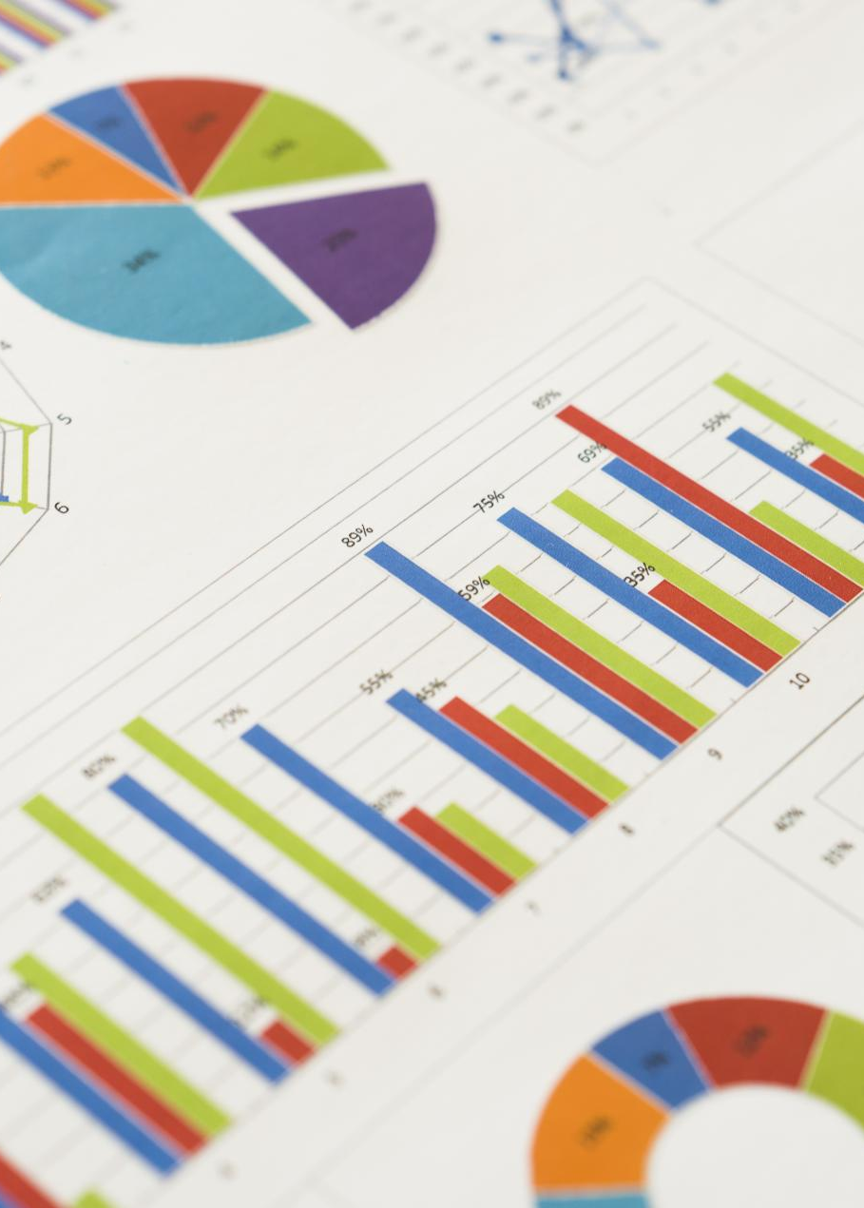
Techniques for EDA
Data Visualization
Visualization techniques help us to represent data graphically, making it easier to identify patterns and insights.
Summary Statistics
Summary statistics provide a quick overview of the data, highlighting key metrics like mean, median, and mode.
Correlation Analysis
Correlation analysis helps us understand relationships between variables, aiding in predictive modeling and decision making.
Notes:
We employ various techniques for EDA, such as visualization, summary statistics, and correlation analysis, to gain a deeper understanding of our data.

Slide 19

Identifying Issues and Problem-Solving Strategies
Identifying Potential Issues
In Exploratory Data Analysis (EDA), we focus on recognizing issues that could hinder our analysis and outcomes.
Effective Problem-Solving Strategies
We employ various strategies to tackle identified challenges, ensuring our analysis remains accurate and reliable.
Notes:
During EDA, we identify potential issues that may impact our analysis. This slide discusses the strategies we employ to address these challenges effectively.

Slide 20

Insights Gained From EDA
Valuable Insights
Exploratory Data Analysis (EDA) uncovers important patterns and trends that inform future analyses.
Guiding Future Analysis
The insights gained from EDA help shape the direction of subsequent data analysis and visualization efforts.
Key Findings Highlighted
This section emphasizes the critical findings from our exploratory analysis that impact decision-making.
Notes:
Conducting EDA provides valuable insights that guide our future analysis and visualization efforts. This section highlights key findings from our exploratory analysis.

Slide 21
ETL Planning and Dashboard Creation
Notes:
ETL (Extract, Transform, Load) planning is crucial for creating effective dashboards. This section outlines our approach to building a master table and designing the dashboard.

Slide 22

Building a Master Table
Data Consolidation
The first step is to gather data from multiple sources for a comprehensive overview.
Structuring the Table
It is essential to organize the table with clear headings and categories to enhance readability.
Ensuring Completeness
Regular checks should be conducted to ensure that all necessary data is included for accuracy.
Notes:
Creating a master table involves consolidating data from various sources. This slide details the steps taken to ensure that our master table is comprehensive and well-structured.

Slide 23
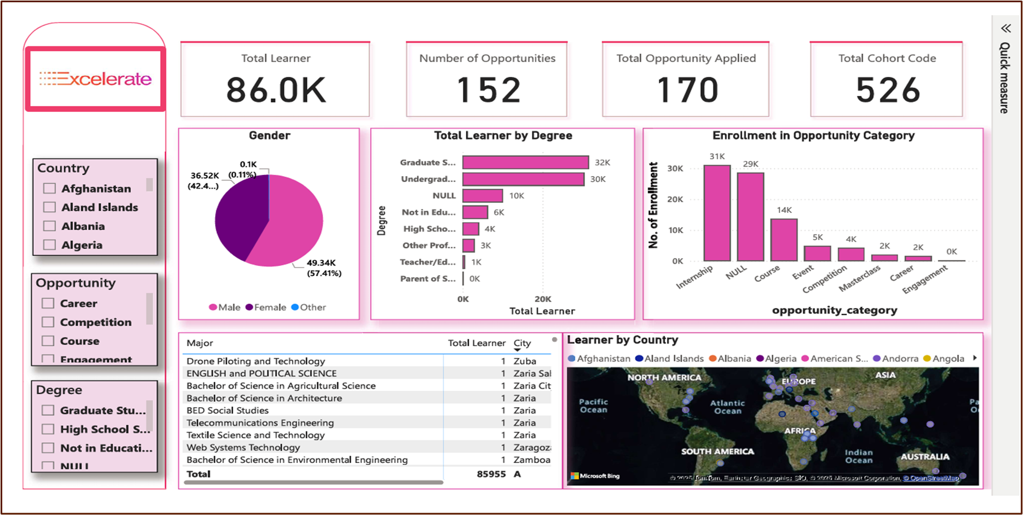
Dashboard of Master Table
Key Metrics Visualization
The dashboard visualizes important metrics to provide insights into data performance and trends.
User-Friendly Interface
Designed for ease of use, the dashboard allows users to interactively explore data and insights effectively.
Functionalities Overview
This section highlights the various functionalities of the dashboard, enhancing data accessibility and analysis.
Notes:
The dashboard we create from the master table visualizes key metrics and insights. This section presents an overview of the dashboard and its functionalities.

Slide 24
Looker Studio Dashboard
Notes:
The Looker Studio dashboard is our final product, integrating all our efforts into a user-friendly interface that presents data insights effectively.

Slide 25

Overview of Looker Studio
Data Visualization Tools
Looker Studio offers a variety of tools designed for effective data visualization, helping users see data in new ways.
Dashboard Creation
The platform simplifies the process of creating interactive dashboards, allowing for dynamic exploration of data.
Capabilities and Advantages
Looker Studio's features provide a competitive edge in data analysis, enhancing decision-making processes within organizations.
Notes:
Looker Studio provides powerful tools for data visualization. This slide offers an overview of its capabilities and advantages in our dashboard creation.

Slide 26

Dashboard Features and Functionalities
Interactive Elements
The dashboard includes interactive elements that allow users to engage directly with the data for better insights.
Dynamic Filters
Dynamic filters enable users to customize their view of the data, making it more relevant to their needs.
Real-Time Data Updates
Real-time data updates ensure that users always have the latest information available, enhancing decision-making.
This Photo by Unknown Author is licensed under CC BY
Notes:
Our Looker Studio dashboard incorporates various features, including interactive elements, filters, and real-time data updates. This section highlights these functionalities.

Slide 27
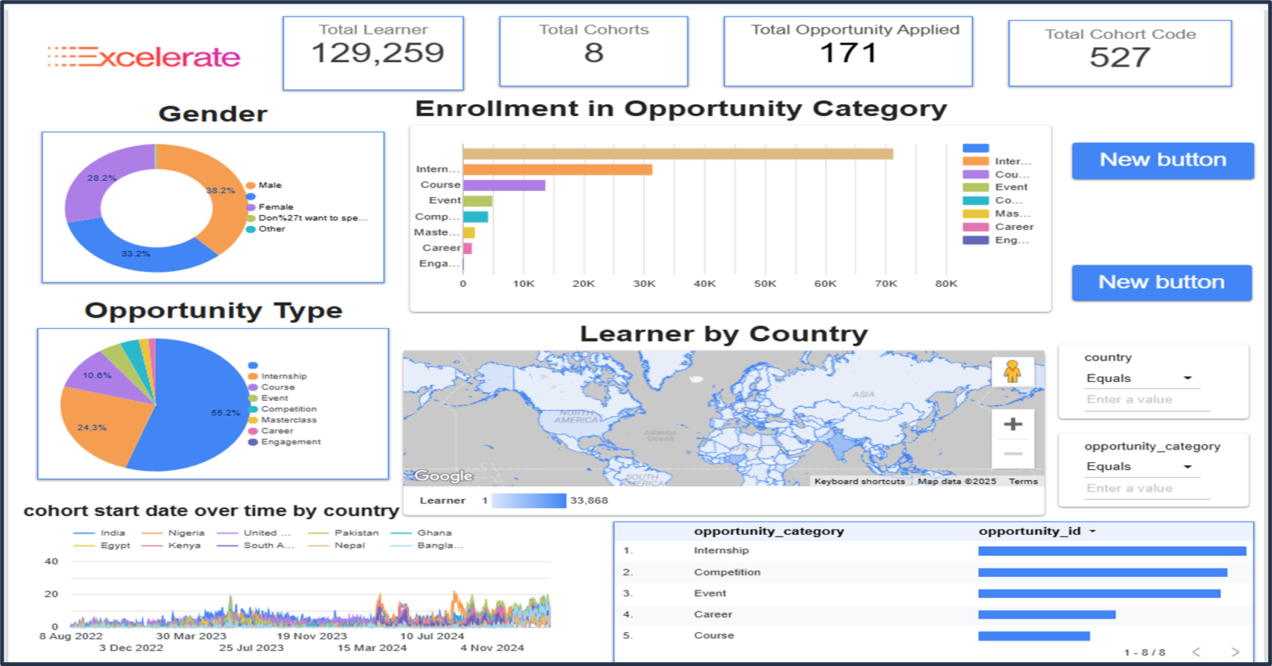
Final Design and Annotations
Completed Dashboard Design
The final Looker Studio dashboard design presents a cohesive visual representation of data insights.
Annotations for Clarity
Annotations are included to clarify visual elements, guiding users through the insights provided.
Visual Elements Significance
Each visual element in the dashboard is designed to convey specific insights and facilitate understanding.
Notes:
In this final section, we will showcase the completed Looker Studio dashboard design, complete with annotations that explain the visual elements and the insights they provide.

Slide 28
Conclusion
Challenging Journey
Our journey in data visualization faced numerous challenges, pushing us to innovate and improve our skills.
Rewarding Insights
Transforming raw data into meaningful insights has been rewarding, helping us empower decision-makers.
Empowering Decision-Making
The dashboards we created provide clarity and empower stakeholders to make informed decisions based on data.
Notes:
In conclusion, our journey in data visualization has been both challenging and rewarding. We have transformed raw data into insightful dashboards that empower decision-making and provide clarity.

Slide 29

Q&A Session
Open the floor for questions from the audience.
Encourage discussion and clarification on presented topics.
Address any concerns or insights shared by participants.
Notes:
This slide invites questions from the audience, allowing for an interactive discussion. It's important to create a welcoming environment where participants feel comfortable asking for clarifications and sharing their insights. Encourage an open dialogue to enrich the learning experience.

Slide 30

Thank You!
Notes:
This slide expresses gratitude to the audience for their attention and participation. Acknowledge the value of their engagement in the project and offer your contact details for any further questions or discussions. Ending on a positive note fosters good relationships for future interactions.

